Slide 1

GKS India Orientation 2026

Slide 2

Contents
• •
Documents to bring Expenses on arrival
•. What to bring
•
Finding your way here-apps and cards
• •
Life in Korea Dos and Don’ts

Slide 3
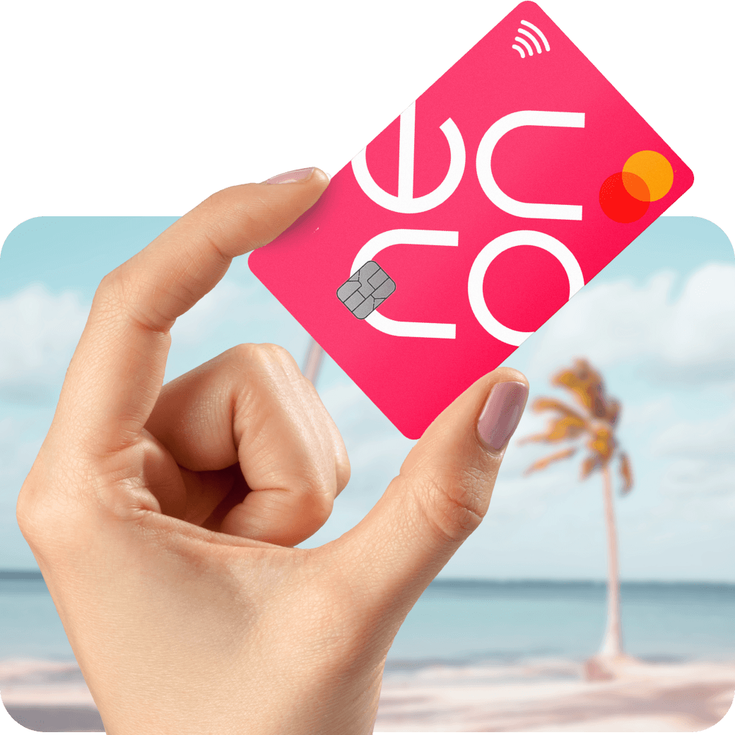
Documents to carry along
• • • •
Graduation certificate Transcript
Forex Card/Neon card*
Passport size photos
*you don’t need to upload the Indian currency unlike forex card. Keep your Indian money in Neon card and just pay here. Money will be Deducted without any interest rate.

Slide 4

Expenses on arrival
•
Bus/Subway back on arrival-Carry ₹20,000-₹25,0000 in cash
$1500-$2000 in forex card
Bedding, Food, Commute for the first 15-20 days
• •

Slide 5

What to bring?
• • • •
Less clothes more food
Universal adapters
Spare glasses
Anti allergens and other basic medicines
  Towel
  Any specific medicine or thing you need to bring

Slide 6

Finding your way
• • • •
Kakao Map
Naver
Metro over bus, taxis on a time crunch Transportation card at convenience stores (CU, GS, 7-11) - T-Money, Climate card*(K-pass)
  Put-book sim (Chingu mobile, Kimbap mobile)
•

Slide 7

Life in Korea
• • •
Don’t have outlandish expectations.
Not everyone knows English.
Get in touch with your acquaintances in Korea and in the city of residence (several facebook and WhatsApp groups)
Have to give up your vegetarian diet unless you can cook or have access to cooking area
•

Slide 8

Dos and Don’ts
Do
Don’t
• • •
Have a thick skin
Get known to your locality Segregate waste
make friends
•
Talk on the phone loudly or eat in public transport.
Litter
don’t put perfumes in public places.
•
•
  Convert prices to
₹

Slide 9
Your questions
1)
Finding jobs- depends on your major and minor. A few universities have job notice boards have your
expectations low as a foreigner. Start applying for jobs and internships from the last semester itself. Keep in mind, being a GKS scholar bars us from applying to several other funded internships so make sure you get your GKS coordinator’s approval before applying to anything.
How to achieve TOPIK quickly?- Study Korean. Kdramas do help with speaking and listening but not
with writing.
Return to your home country on a D4 Visa is permissible during semester breaks. Leaving the
country without prior permission may lead to serious repercussions.
Avoiding housing scams- Have a contract.
T money card/climate card does not work for the airport buses. Carry card or cash to get tickets.
Use Naver for everything (contacting brokers, restaurants, finding your way, etc.)
Beware of people who strike up unnecessary conversations in the middle of the street! (cult is something you should avoid here.)
2)
3)
4) 5) 6) 7)

Slide 10

Priya Rani
GKS-G
2024-2027

